Slide 2
HIV RELATED DISEASES
OPPORTUNISTIC INFECTIONS (OIs)

Slide 3
OBJECTIVES
List the common opportunistic infections, skin conditions and malignancies seen in HIV infected adults
Describe their clinical presentation and management
Describe primary and secondary preventive strategies

Slide 4
Important Messages about OIs
Opportunistic infections cause the vast majority of the morbidity and mortality associated with HIV
Most are readily treatable and/or preventable
Most of these treatments are simple, available and affordable

Slide 5
Brainstorming session…
What are the most common and the most important opportunistic infections seen in Kenya?

Slide 6
Common Opportunistic Infections
Tuberculosis
Bacterial infections
Pneumonia
Gram negative sepsis
Pneumocystis carinii pneumonia -PCP (now Pneumocystis jirovecii pneumonia- PJP)
Cryptococcal meningitis
Toxoplasmosis
Candidiasis
Infective diarrhoea
Herpes Zoster
Infective Dermatoses

Slide 7
HIV Related Malignancies and Other conditions
Malignancies
Kaposi’s sarcoma
Primary CNS lymphoma
Carcinoma of the cervix
Other lymphomas - NHL
Other conditions
HIV wasting syndrome
Non infective dermatosis

Slide 8
Tuberculosis

Slide 9
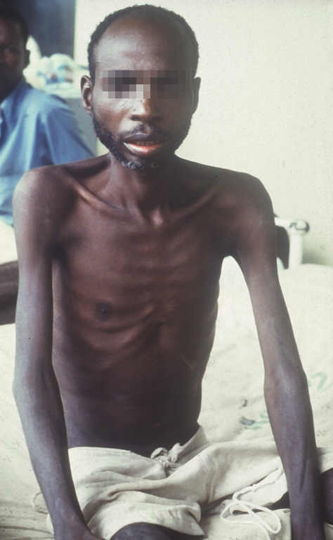
A Patient with HIV Wasting Syndrome
This can be clinically indistinguishable from advanced TB

Slide 10
TB/HIV: Conclusion
TB a major cause of morbidity and mortality in HIV patients
TB occurs at any stage of HIV infection
EPTB/atypical presentations of TB more common in severe HIV disease
All co-infected patients should be started on cotrimoxazole prophylaxis as it reduces mortality
HIV patients on ART remain at risk of developing TB; active case detection important

Slide 11
Pneumocystis Jiroveci Pneumonia

Slide 12
Pneumocystis jiroveci Pneumonia (PCP)
Clinical Presentation
Symptoms:
Shortness of breath / respiratory distress
Onset of illness insidious often taking weeks. Can be acute
Cough
Usually dry
Fever
Signs:
Tachypnea
Tachycardia
Cyanosis
Lung auscultation often normal or bilateral crepitations without reduced air entry
Notes:
P. Carinii pneumonia has been renamed P. jiroveci although the eponym PCP is retained. Causal agent a fungus. People at risk of PCP have defects in cellular and humoral immunity including malnourished children, primary immunodeficiency states, use of steriods and in HIV. Incidence of PCP rises dramatically when CD4 count falls < 200.
Transmission is by airborne inhalation.
SOB the hallmark of PCP

Slide 13
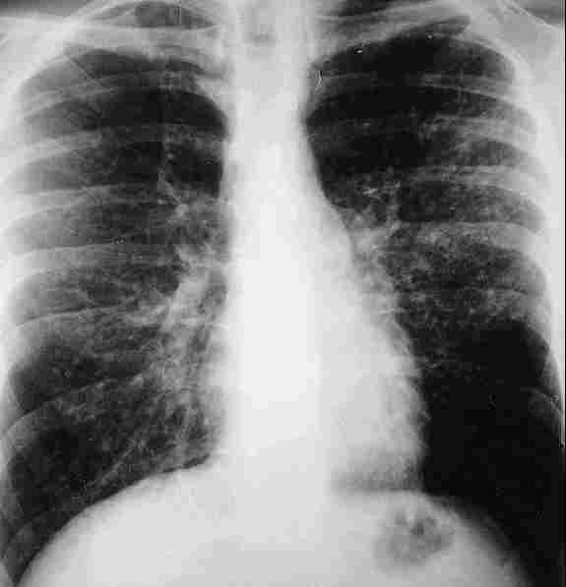
Pneumocystis Jiroveci Pneumonia Diagnosis
High index of suspicion
Chest radiograph
Classically bilateral, diffuse interstitial shadowing
Can be relatively normal even with severe respiratory distress
Induced sputum and Bronchoalveolar lavage
Can give definitive diagnosis
Rarely available or possible
Clinical suspicion key to diagnosis
Notes:
CXR NORMAL IN 10-20%. If available staining of sputum and BAL with silver or methenamine. Monoclonal Ab stains more sensitive. CT scan where available can be useful in patients with normal CXR. Arterial blood gas where available to help determine whether O₂ needed

Slide 14
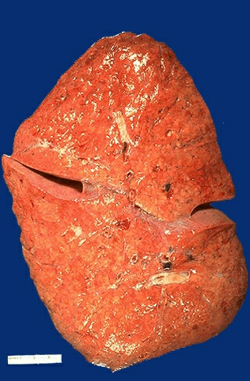
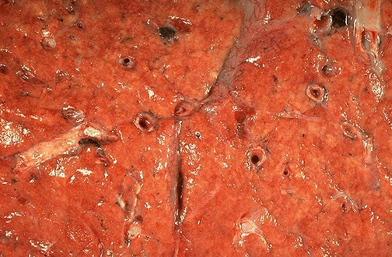
PJP: Postmortem
Notes:
Histopathologic specimens showing

Slide 15
PJP: Management
Severe disease
High dose cotrimoxazole for 21 days
120mg/kg per day in 3-4 doses e.g. dose for 60kg man is 7200mg/day
7200mg = 15 x 480mg tablets = approx 4 tabs QDS
If allergic to or intolerant of cotrimoxazole
Clindamycin at 900mg IV 8 hourly plus primaquine 30mg orally/day. Clindamycin may also be given orally at a dose of 600mg 6 hourly.
For mild to moderate disease
Trimethoprim 15mg/kg/day + Dapsone 100mg/day PO for 21 days
Notes:
Lower doses of 90mg/kg have been used with success. This reduces side effects which include fever, rash, leukopenia, thrombocytopenia, hepatitis, hyperkalemia

Slide 16
PJP management cont’d
Prednisone is beneficial if severe respiratory distress or cyanosis present.
Dose-40mg BD for 5 days, then 40mg OD for 5 days, then 20mg OD for 5 days then STOP.
Supportive therapy
Oxygen therapy
IV fluids
Nutrition
Monitor blood
cotrimoxazole toxicity
Multi organ dysfunction in the severely ill
Secondary prophylaxis needed after treatment complete
Notes:
Prognosis of PCP poor especially in severe disease. Early diagnosis key to successful outcome. Ventilatory support of patients justifiable where possible since ART is now available improving chances of long term survival in those who recover.
Treatment failure as a result of cotrimoxazole resistance unlikely even in patients who have been on prophylaxis

Slide 17
PCP Prophylaxis: Cotrimoxazole 960 mg OD
Primary prophylaxis
Current recommendation: ideally ALL HIV positive patients should be given cotrimoxazole prophylaxis, which is effective against PCP
Notes:
Primary prophylaxis (preventive therapy prior to development of the infection being prevented)

Slide 18
Secondary Prophylaxis
Prior to the availability of ART, patients who had experienced an episode of PJP were given cotrimoxazole prophylaxis for life
With ART, immune reconstitution occurs
In industrialized countries, primary and secondary cotrimoxazole prophylaxis is now safely discontinued once immune recovery is established
Notes:
Secondary prophyalxis: patients who have had an episode of PJP more likely to suffer a subsequent episode as compared to a first episode in those who have never had PJP. Secondary prophylaxis is preventive therapy to prevent a recurrent episode.
The spectrum of HIV related diseases in Sub Saharan Africa is different from that seen in industrialized countries; various bacterial and parasitic pathogens (other than Pneumocystis jiroveci and T. gondii) such as non typhi salmonellae (NTS), Streptococcus pneumoniae other gram negative enteric bacilli, and Isospora belli, are major non-tuberculous causes of HIV-1-related morbidity. These infections occur at a higher incidence in Africa than in industrialized countries and at an earlier stage of HIV disease than PCP

Slide 19
Cotrimoxazole Prophylaxis in Kenya
Cotrimoxazole has been shown to reduce
Morbidity across all ranges of CD4
Mortality in those with symptoms and CD4<200
Current recommendation: cotrimoxazole (primary and secondary) prophylaxis should not be discontinued even in patients on ART
In Africa, in addition to Toxoplasmosis and PCP, cotrimoxazole prevents a lot of other infections/organisms including
Community-acquired bacterial pneumonia, Staph. aureus
Non-typhi salmonella, other gram negative GI organisms
Malaria, Isospora,
These infections occur at a higher incidence in PLHA than in HIV negative
Notes:
The Opportunistic Infections Subcommittee of the ART Task Force has deliberated on the available evidence on the use of cotrimoxazole chemoprophylaxis in PLHA in Africa. It has taken into account local limitations, particularly with regard to availability of human and laboratory resources to assess patients at entry in to and exit out of this intervention. Following this, it is the decision of the Subcommittee to recommend that ALL HIV infected patients regardless of age, immunological or clinical status, be given cotrimoxazole prophylaxis unless contraindicated. The recommendation also covers continuation of chemoprophylaxis in all patients on ART. This decision will be subject to review should evidence emerge to support changes and/or amendments
It is important that patients not eligible for ART be given cotrimoxazole because there is emerging evidence that the use of cotrimoxazole in these patients may slow disease progression

Slide 20
Cotrimoxazole intolerance/allergy
Cotrimoxazole well tolerated in African patients
If allergic to CTX desensitization should be carried out
Very important in view of the efficacy of this drug as a prophylactic agent against many organisms
If above fails then use Dapsone 100mg OD
Effective against PCP and Toxoplasmosis
Should be discontinued following established immune reconstitution
Notes:
Results: 50% patients able to tolerate it following desensitization in Western populations therefore worth doing.

Slide 21
Desensitization for cotrimoxazole allergy
Standard desensitization
Day | Dose of CTX
1 | 0.5 ml
2 | 1 ml
3 | 2 ml
4 | 3 ml
5 | 4 ml
6 | 5 ml

Slide 22
Cryptococcal Meningitis

Slide 23
Cryptococcal Meningitis: Clinical presentation
Caused by yeast like fungus Cryptococcus neoformans
Symptoms
Headache
Severe - can come on over weeks
Fever
Often absent in early stages
Neck stiffness
Often absent in early disease
Signs
Abnormal gait, cranial nerve palsies less common
Papilloedema
Confusion, convulsions and coma
Notes:
Infection is through inhalation of fungal spores. Pulmonary infection often asymptomatic. Dissemination through blood stream occurs including to CNS. Infection occurs in the immunocompromized. *If focal signs are present, CT scan useful before LP; focal signs often indicate raised ICP which requires urgent relief (LP and drainage repeatedly to ease ICP may be required)

Slide 24
Cryptococcal Meningitis: Diagnosis
High index of clinical suspicion
Lumbar puncture - most useful
Raised intracranial pressure
Usually mild lymphocytosis
India ink stain – positive in 60-80% cases
Negative India ink does not exclude CM
Cryptococcal Antigen Test (CRAG) – if possible
Highly sensitive and specific (>95%) – expensive
Useful in differentiating from TB meningitis
Very similar in presentation and CSF cell/biochemistry profile

Slide 25
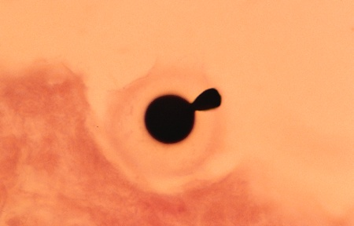
Cryptococcal meningitis
Indian ink stain showing budding yeast of C. neoformans

Slide 26
Cryptococcal Meningitis: Management
For severe/advanced disease:
Amphotericin B 0.7-1mg/kg daily for 2 weeks/until clinically stable
Followed by:
Fluconazole 400mg daily for 8-10 weeks
If diagnosed early/ amphotericin unavailable:
Fluconazole 400-800mg daily for 10-12 weeks alone
Treatment failure and mortality higher
Notes:
Fluconazole available “Free” through Donation Program
Affordable (WHO Approved) generic versions also available

Slide 27
Cryptococcal Meningitis: Management
Supportive treatment
If raised ICP as indicated by severe headache, visual disturbances perform repeated lumbar puncture (e.g. 30ml CSF per day)
Reduces mortality
Reduces blindness
Helps with pain and consciousness level
No evidence of benefit from steroids
These are beneficial in TB Meningitis
Support of the patient with impaired consciousness

Slide 28
Cryptococcal Meningitis: prophylaxis
Maintenance therapy-secondary prophylaxis
Fluconazole 200mg OD
If on ART continue until CM therapy completed AND CD4 established at >100 for more than 6 months
Relapse rare with prophylaxis and immune reconstitution due to ART
Primary prophylaxis: not recommended
Notes:
If CD4 count falls below 100 in a patient with a history of CM, fluconazole prophylaxis should be re-instituted

Slide 29
Toxoplasmosis

Slide 30
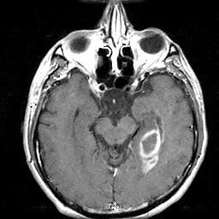
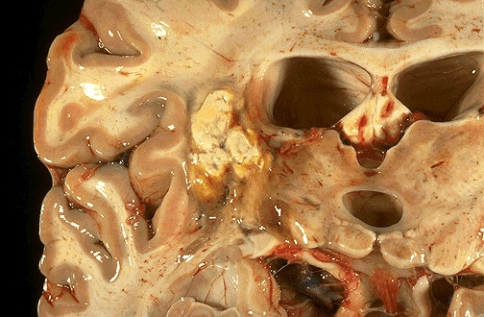
Toxoplasmosis
Notes:
Typically >/= 2 ring enhancing lesions on CT. postmortem

Slide 31
Toxoplasmosis
Caused by Toxoplasma gondii
a protozoan whose definitive host is the cat
Humans infected by ingestion of T. gondii in food contaminated with cat feces or undercooked meat
Vertical transmission occurs
serious consequences if it occurs in the 1st trimester
Asymptomatic in >90% of immunocompetent adults and children
Commonly a result of reactivation of latent disease in patients with AIDS and those on chemotherapy for lymphoproliferative disorders
CD4 < 100 cells/mm³
Commonly encephalitis

Slide 32
Toxoplasmosis: Clinical Presentation
Symptoms
Can be acute or progressive
Headache
Occurs in about 70%
Can be severe – usually no meningism
Neurological deficits
Fever
Only in 50% at presentation
Confusion
Sometimes presents as subtle personality change
Convulsions
Signs
Focal neurological deficit
Progressive paralysis
Blindness
Cerebellar signs, incontinence
Fever
Notes:
Cats definitive host of T. gondii. Acquired through eating foods contaminated with oocysts excreted in cat feces or ingestion of brdyzoites in undercooked meat. Vertical transmission also occurs. Acute infection in the immonocompetent symptomatic in the majority; otherwise symptoms similar to those of a viral illness occur and resolve over several weeks. Intrauterine infection more severe if it occurs in early pregnancy. Risk of acute infection greatest in the immunocompromized. Often secondary to reactivation of latent infection.

Slide 33
Toxoplasmosis: Diagnosis
Typically CD4 <100
CT ideal if available – =/>2 ring enhancing lesions
High index of clinical suspicion needed
“An HIV positive patient with headache, confusion and signs of a SOL, with a relatively normal CSF has Toxoplasmosis until proven otherwise”
Differential diagnosis – Tuberculoma, bacterial abscess, CVA, primary CNS lymphoma.
A response to empirical treatment is virtually diagnostic
Usually within 2 weeks

Slide 34
Toxoplasmosis: Management
Pyrimethamine – 200 mg loading dose followed by 50 daily
+
Sulphadiazine – 1 g -1 .5 g OD
+
Folinic acid – 20mg daily for 6 -8 weeks
Or
Cotrimoxazole - 4 -6 weeks
25mg/kg daily of sulphamethoxazole or 5mg/kg TMP in two divided doses
E.g. 60kg man
1800mg/day = 3.7 Tablets = Approx 2 Tablets BD
Maintenance therapy
Pyrimethamine 50mg + Sulphadiazine 1g + Folinic acid 20mg OD until CD4 >200 for more than 6 months (clindamycin 300mg OD can replace sulphadiazine)
Notes:
Clinical response expected in 1 week in 60-80%. If no response with in 2 weeks consider alternative diagnosis

Slide 35
Prevention of toxoplasmosis
Basic food hygiene
Eating well cooked meats
These may not be very important since most infection a result of reactivation of latent disease

Slide 36
Prevention of toxoplasmosis
Primary prophylaxis
Cotrimoxazole 960mg per day
In the West started when CD4 < 200 cells/mm³
Primary prevention covered with standard cotrimoxazole prophylaxis given to all HIV patients as recommended
“Secondary prophylaxis” same as maintenance therapy above
Used to be life long prior to ART
Can be safely discontinued after established immune reconstitution (CD4 >200 for >> 6 months)

Slide 37
Bacterial Pneumonia

Slide 38
Bacterial pneumonia Clinical presentation
Acute, productive cough
Fever
Chest pain
Breathlessness
Signs of consolidation

Slide 39
Bacterial Pneumonia: Management
Amoxicillin
or
Erythromycin
or
Cephalosporin
NB: Cotrimoxazole effective prevention against bacterial pneumonia
Notes:
Note that by the time many patients present with pneumonia antibiotics will have been used already therefore the need to consider second line treatment. Strep. Pneumoniae resistance to cotrimoxazole in Kenya is extremely common so this drug should not be used empirically in patients with pneumonia especially those on the same for prophylaxis. Newer generation quinolones alternative in patients who fail the above (e.g. levofloxacin). Note ciprofloxacin not effective for treating strep pneumonia infection. Pneumococcal vaccine trials in adults in Africa were not effective (in fact had a deleterious effect)

Slide 40
Candidiasis

Slide 41
Candidiasis
Vaginal
Not strictly an OI unless chronic (>1month) or unresponsive to treatment
Oropharyngeal
Very common
WHO Stage III defining - CD4 usually <300
Esophageal
Significant cause of morbidity and mortality
WHO Stage IV defining - CD4 usually <100

Slide 42
Vaginal Candidiasis
Clotrimazole Vaginal Pessaries
200mg daily for 3 days OR 500mg stat
Alternative
Fluconazole 150mg stat
Recurrent (>>4 episodes per year)
Clotrimazole pessary 500mg weekly
Fluconazole 100 mg weekly

Slide 43
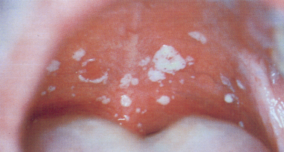
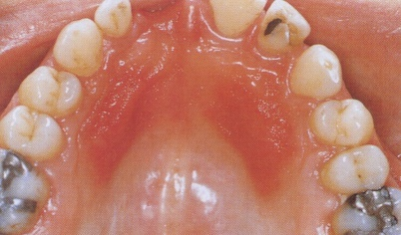
Oro-pharyngeal Candidiasis
White pseudomembraneous plaques, atrophic /erythematous, angular cheilitis
Treatment
Nystatin drops or tablet
500,000 IU QDS
Miconazole Oral Gel
60mg QDS
Miconazole Buccal Tablet
OD for 7 days
If unresponsive:
Fluconazole 100mg OD for 7 days

Slide 44
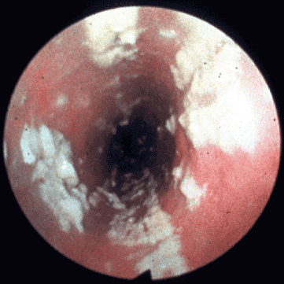
Esophageal Candidiasis
Causes painful swallowing (odynophagia)
Results in inadequate oral intake
Dehydration, malnutrition, wasting
Treatment:
Fluconazole 200mg stat, then 100mg daily for 14 days
Ketoconazole
200mg daily for 14 days
Maintenance therapy required unless immune reconstitution occurs. All such patients should be evaluated for ART

Slide 45
Infective diarrhoea

Slide 46
Infective Diarrhea
Acute diarrhea (>3 loose motions/day x < 2 weeks)
Stool cultures where possible
If acutely unwell and pyrexial with blood in stool
Consider a quinolone (ciprofloxacin 500mg BD x 10-14 days)
Remember drugs as a cause of diarrhea including antibiotics
Chronic/recurrent diarrhea (>1month)
Copious amount of watery diarrhea associated with abdominal pain, +/- fever
Symptoms intermittent. CD4 < 200
Often associated with wasting, malabsorption
Cause usually not identified in practice; rule out acute infections where possible
Cotrimoxazole reduces incidence of diarrhea in PLHA

Slide 47
Infective Diarrhea: Management
Oral rehydration therapy
IV fluids
If severe dehydration
Antimicrobials
If possible, treat according to stool analysis
Stool analysis often not helpful
Empirical treatment justified in chronic, debilitating diarrhea
Symptomatic treatment a relief to patients

Slide 48
Empirical Management of Chronic Diarrhea
Trial of Cotrimoxazole – 2 tabs BD 5 days (not in patients already on cotrimoxazole prophylaxis)
If no improvement:
Trial of Metronidazole – 400mg QDS 7 days
If no improvement:
Trail of an Antihelminthic – e.g. Albendazole
If no improvement:
Symptomatic management
Eg: Loperamide, Diadis, dietary advice etc.
ART effective in eliminating chronic diarrhea

Slide 49
Skin Conditions
Infective Dermatitis

Slide 50
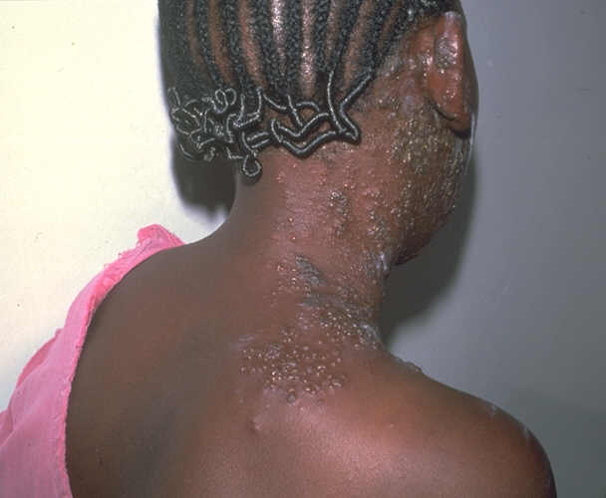
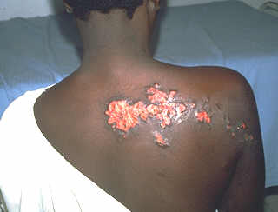
Herpes Zoster
Reactivation of previous varicella (chicken pox)
Very common
Can occur early in HIV disease
Multi-dermatomal, recurrent
Causes acute, severe pain
Risk of debilitating post herpetic neuralgia (PHN more common in older patient)
Disfiguring keloid formation
Diagnosis clinical

Slide 51
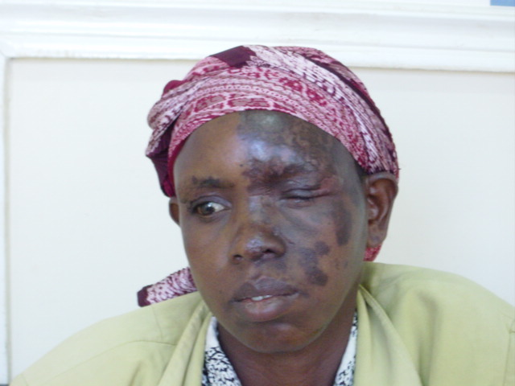
Opthalmic Herpes Zoster
Risk of permanent visual impairment
Need to treat early
Need to treat aggressively (IV aciclovir if possible)
Healed Opthalmic HZ
Notes:
Infection of the ophthalmic division of the trigeminal nerve. May be associated with the Ramsay Hunt syndrome = involvement of the sensory branch of the facial nerve, lesions in the ear canal, ipsilateral facial nerve palsy and loss of taste anterior 2/3 of tongue

Slide 52
Herpes Zoster: Management
Analgesics – for acute pain
Paracetamol plus an NSAID (+/- an opiate)
Apply calamine lotion regularly
Reduces itch and secondary infection
If presents with new lesions
Give Aciclovir (the sooner the better)
Reduces acute pain, duration of lesions, number of new lesions and systemic complaints
ACV does not alter the rate of PHN
Notes:
Frangipani sap ?proven to be effective
Free and found widely in Kenya
Valaciclovir may be advantageous in reducing rate of PHN compared to ACV

Slide 53
Aciclovir for Herpes Zoster
Aciclovir 800mg 5 times a day for 7-10 days
If visceral/extensive or disseminated or ophthalmic where possible give IV aciclovir (10mg/kg TDS)

Slide 54
Post Herpetic Neuralgia
Difficult to treat
Pain difficult for patients to define - pricking, tingling, burning
Treatment
Amitryptiline 25-50mg at night
Carbamezipine 100mg BD (up to 200mg TDS)
Can be used in combination
Warn patients that it takes up to weeks to notice the benefit
“Don’t give up on the tablets too soon”

Slide 55
Types of Genital Herpes
First episode: primary infection, non-primary infection
Recurrent episode
Asymptomatic episode

Slide 56
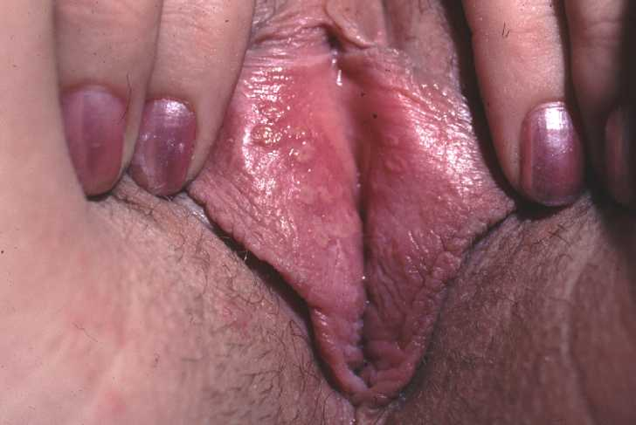
Genital Herpes
Red, raised, tender vesicles or lesions may occur anywhere on the vulva, in the vagina, or on the cervix or anal area.
Multiple vesicles may occur.

Slide 57
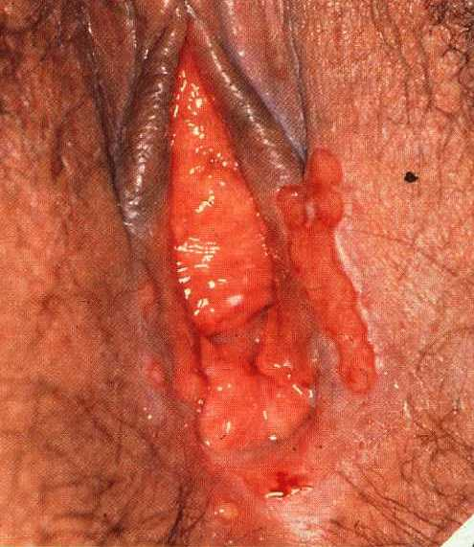
Genital Herpes
Vesicles coalesce, become denuded and form large ulcers

Slide 58
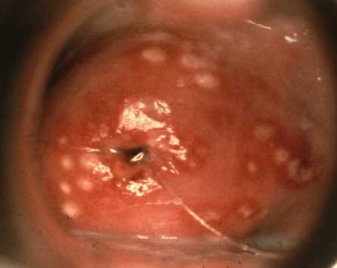
Genital Herpes—Recurrence on the Cervix

Slide 59
HIV and Genital Herpes
More extensive disease
Frequent recurrences
Chronicity
Associated high genital viral load
Important cofactor for transmission of HIV
Treatment of first episode as standard however higher doses may be required for longer periods especially in chronic cases

Slide 60
Infective Dermatoses
Can be very debilitating and disfiguring; significant cause of stigmatization
Scabies
Sarcoptes scabiei
Very common – under diagnosed and under treated
Papular intensely itchy rash
Often not of the typical appearance
Norwegian scabies - extensive skin involvement with crusting of lesions seen in immunocompromized patients
Seborrheic dermatitis
Pityrosporum yeast
Erythematous plaques with scales at the edge of scalp around nose and ears
Treat with 2.5% hydrocortisone with antifungal cream + tar based /antifungal shampoos
Other fungal skin infections

Slide 61
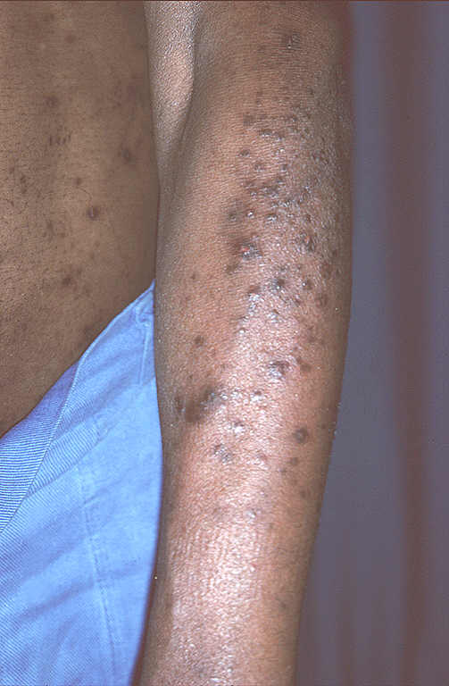
Papular Pruritic Eruption (PPE)
AKA Prurigo Nodularis
Cause unknown
Occurs with CD4<200
Severe itching, with hyperpigmented, hyperkeratotic, excoriated papules and nodules
Associated thickening of skin (lichenification)and scarring
This rash could be scabies or PPE

Slide 62
Management of Infective Dermatoses
Scabies
Consider an empirical trial of therapy for any patient with a very itchy rash
Benzyl Benzoate at night, for 3 nights
Remember itchiness may persist for 1-2 weeks after treatment
Treatment of household contacts
Fungal Infections
Eg: Clotrimazole cream. Griseofulvin or Fluconazole if severe or resistant to treatment
Calamine can relieve itch
Steroids should only be used as a very last resort
Greatly overused

Slide 63
Management of PPE
PPE
Chlorhexidine/Cetrimide ointment provides great benefit to some
Antihistamines
ART

Slide 64
HIV associated Malignancies

Slide 65
HIV Associated Malignancies
Kaposi’s Sarcoma (Human Herpes 8)
Lymphomas
HPV associated carcinoma (cervical and anal)

Slide 66
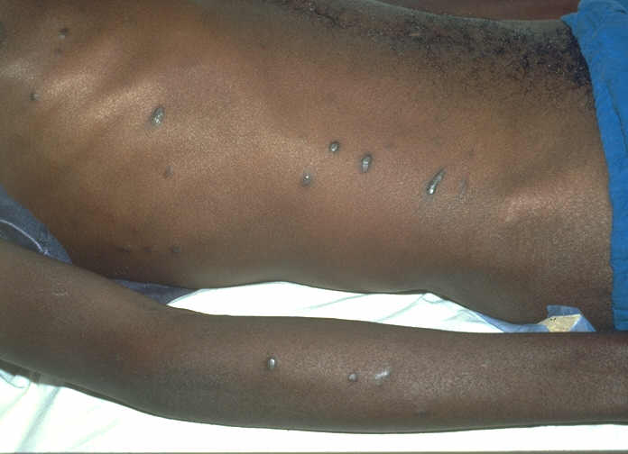
Kaposi’s Sarcoma
Many times more common in HIV positive than negative
Firm dark nodules, papules, patches that are not symptomatic
Skin
Oropharyngeal
Multisystem (GI, lungs)
WHO Stage IV/AIDS defining
Clinical diagnosis; biopsy if uncertain

Slide 67
Kaposi’s Sarcoma: Management
Prognosis depends on extent of disease and CD4 count
ART associated with
reduced incidence of KS
regression of lesions
prolonged survival
Incurable condition; treatment aims to reduce symptoms and prevent progression
Notes:
Newer therapies extremely expensive and include liposomal anthracyclines and paclitaxel. Weight vs surface area chart

Slide 68
Kaposi’s Sarcoma: Management
Local therapy
Disease limited to skin, relatively few lesions, no systemic symptoms
Radiotherapy
Intra-lesional vincristine
Systemic treatment for extensive disease, systemic involvement
Combination chemotherapy- vincristine + bleomycin
Vincristine alone
These drugs are toxic and should preferably be given by a medical officer and patients should be monitored closely. If necessary refer patient
Notes:
Vincristine 1.4mg/m² +Bleomycin 10 units/m² 2 weekly for 6 episodes. Vincristine 1.4mg/m² weekly for 6 weeks

Slide 69
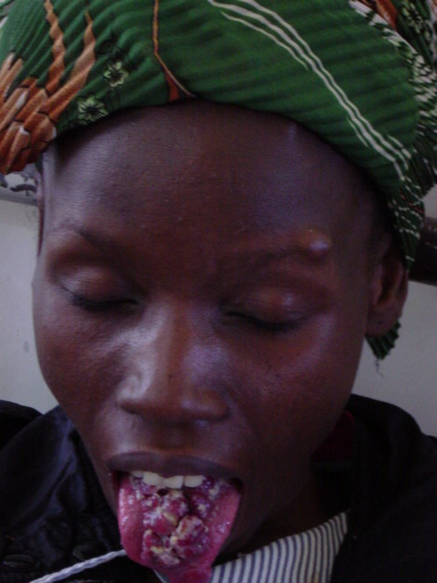

Before
After Chemotherapy

Slide 70
Lymphoma
Primary CNS Lymphoma
EBV associated
Much more frequent and commonest lymphoma in HIV infected
Incidence somewhat reduced by effective ART
Usually CD4 low (<50)
CNS symptoms without fever
Diagnosis: CT scan, failure to respond to empiric Toxo treatment
Treatment: refer (DXT, steroids, chemo). Poor outcome. Effective ART prolongs survival

Slide 71
Lymphoma
Non Hodgkin’s Lymphoma
More frequent in HIV infected
Caused by EBV in the presence of immunosuppression (CD4<100)
More likely to present with systemic symptoms (fever, hepatitis, effusions GI)
Biopsy required for diagnosis
Treatment: refer (combination chemo and steroids)

Slide 72
Cervical Cancer
HIV related immunosuppression is associated with cervical intraepithelial neoplasia (CIN) and cervical cancer
Invasive cervical cancer has been an AIDS defining illness since 1993.
The presence of HIV infection allows permissive replication of human papilloma virus (HPV), the causative agent
More aggressive and more likely to persist
There may be an increased risk of rapid progression from CIN to cervical carcinoma.
With highly active antiretroviral therapy (HAART) CIN tends to regress with rising CD4 count and falling viral load.

Slide 73
Cervical Cancer
In Kenya, cervical cancer is the number 1 cancer causing death in women.
less than 1% of the population at risk is screened.
Kenya unable to master the resources required for a Pap smear based screening program.
Visual approaches using either acetic acid (vinegar. VIA) or lugol’s iodine (VILI) to detect precursor cervical disease/cancer can be alternative in our setting
Both VIA and VILI and have been shown to be much more sensitive than the standard Papanicolaou smear
Visual approach based services are being set up

Slide 74
Cervical cancer
Cervical cancer is largely a preventable disease
Behaviour Change Communication (BCC) - reduction of acquisition of STIs.
Cervical screening programs.
Where possible HIV infected women should undergo cervical screening at enrollment (and annually)
Notes:
VIA/VILI - main drawback is however, a low specificity compared to Pap smear, with false positive results and a tendency towards over treatment5. Nonetheless this is a method of screening that would be relatively easy to adapt for use in countries like Kenya.

Slide 75
Summary
OIs and HIV related conditions cause most of the morbidity and mortality in PLHA
Cotrimoxazole prophylaxis is a greatly underused, cheap, simple and highly effective preventive therapy against many OIs
Most OIs are readily treatable
ART with resultant immune reconstitution greatly reduces the incidence and outcome of most HIV related conditions

Slide 76
Questions??

